Slide 1
Indexing and Hashing
Dr. M. Brindha
Assistant Professor
Department of CSE
NIT, Trichy-15

Slide 2
Basic Concepts
Indexing mechanisms used to speed up access to desired data.
E.g., author catalog in library
Search Key - attribute to set of attributes used to look up records in a file.
An index file consists of records (called index entries) of the form
Index files are typically much smaller than the original file
Two basic kinds of indices:
Ordered indices: search keys are stored in sorted order
Hash indices: search keys are distributed uniformly across “buckets” using a “hash function”.
search-key
pointer

Slide 3
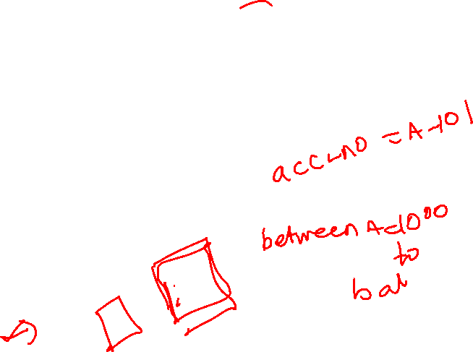
Index Evaluation Metrics
Access types supported efficiently. E.g.,
records with a specified value in the attribute
or records with an attribute value falling in a specified range of values.
Access time
Insertion time
Deletion time
Space overhead

Slide 4
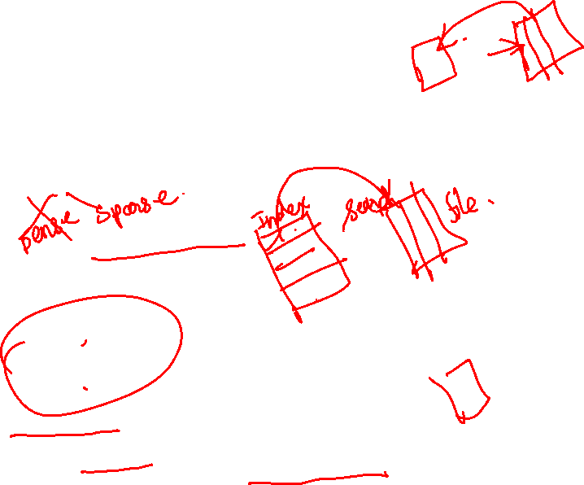
Ordered Indices
Indexing techniques evaluated on basis of:
In an ordered index, index entries are stored sorted on the search key value. E.g., author catalog in library.
Primary index: in a sequentially ordered file, the index whose search key specifies the sequential order of the file.
Also called clustering index
The search key of a primary index is usually but not necessarily the primary key.
Secondary index: an index whose search key specifies an order different from the sequential order of the file. Also called non-clustering index.
Index-sequential file: ordered sequential file with a primary index.

Slide 5
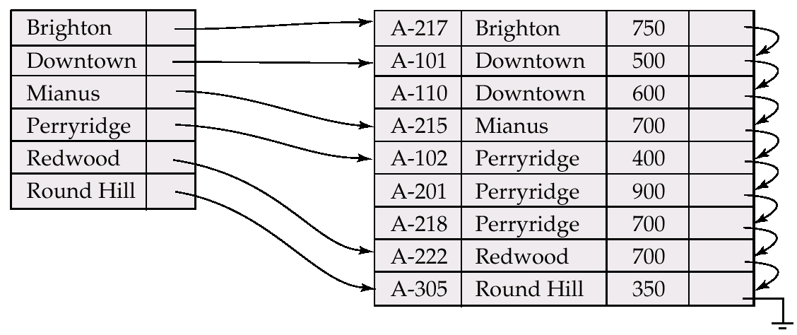
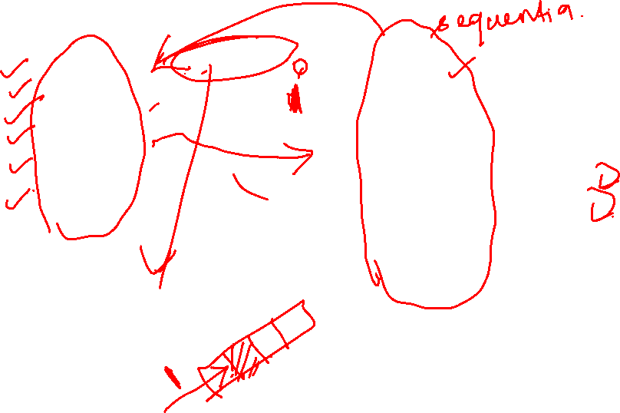
Dense Index Files
Dense index — Index record appears for every search-key value in the file.

Slide 6
Sparse Index Files
Sparse Index: contains index records for only some search-key values.
Applicable when records are sequentially ordered on search-key
To locate a record with search-key value K we:
Find index record with largest search-key value < K
Search file sequentially starting at the record to which the index record points
Less space and less maintenance overhead for insertions and deletions.
Generally slower than dense index for locating records.
Good tradeoff: sparse index with an index entry for every block in file, corresponding to least search-key value in the block.

Slide 7
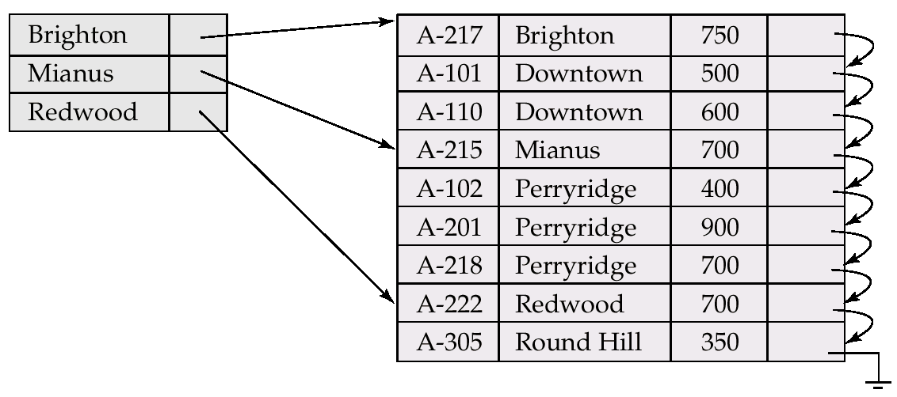
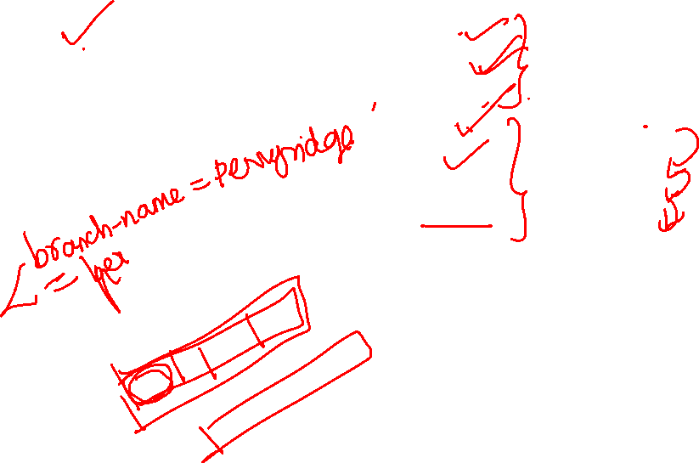
Example of Sparse Index Files

Slide 8
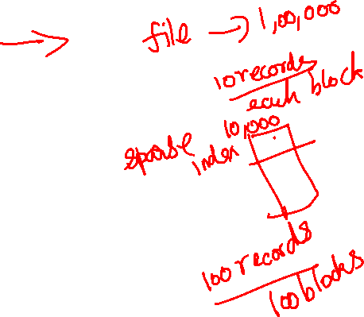
Multilevel Index
If primary index does not fit in memory, access becomes expensive.
To reduce number of disk accesses to index records, treat primary index kept on disk as a sequential file and construct a sparse index on it.
outer index – a sparse index of primary index
inner index – the primary index file
If even outer index is too large to fit in main memory, yet another level of index can be created, and so on.
Indices at all levels must be updated on insertion or deletion from the file.

Slide 9
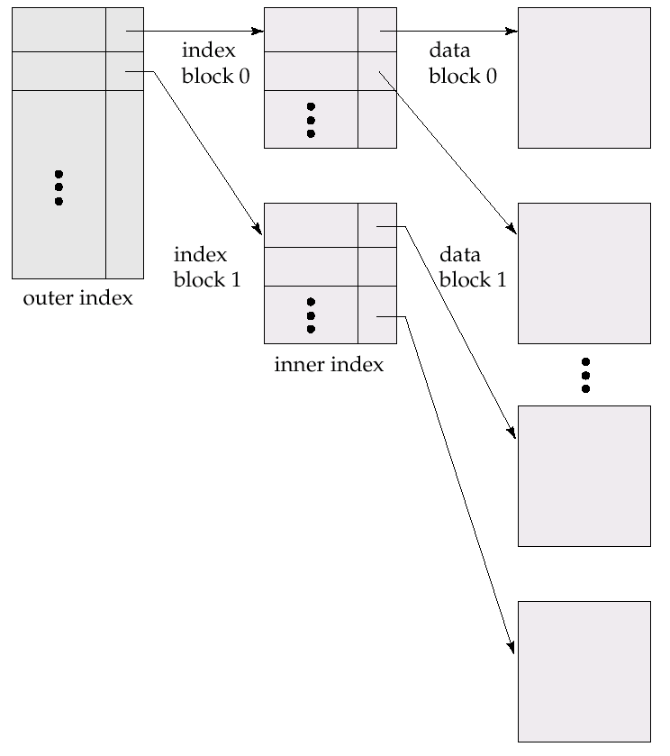
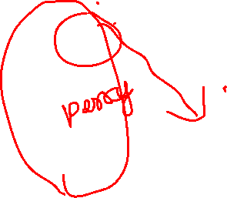
Multilevel Index (Cont.)

Slide 10
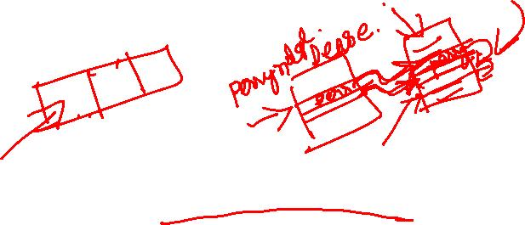
Index Update: Insertion
Single-level index insertion:
Perform a lookup using the search-key value appearing in the record to be inserted.
Dense indices – if the search-key value does not appear in the index, insert it.
If the index record stores pointers to all records with same search key value-add pointer to new record
Index record stores a pointer to only the first record with the search key value-place the record after other record with same search key value
Sparse indices – if index stores an entry for each block of the file, no change needs to be made to the index unless a new block is created. In this case, the first search-key value appearing in the new block is inserted into the index.
Multilevel insertion (as well as deletion) algorithms are simple extensions of the single-level algorithms

Slide 11
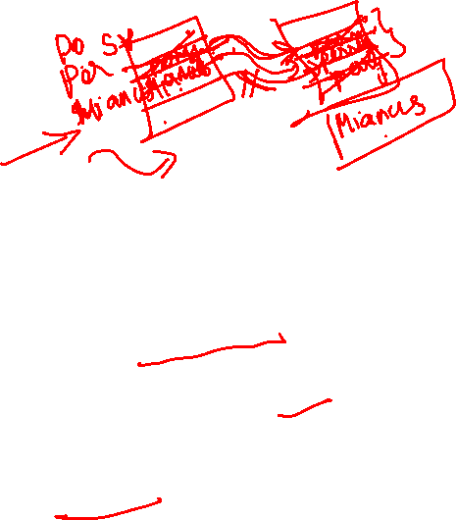
Index Update: Deletion
If deleted record was the only record in the file with its particular search-key value, the search-key is deleted from the index also.
Single-level index deletion:
Dense indices – deletion of search-key is similar to file record deletion.
If the index record stores pointers to all records with same search key value-delete pointer from the record
Index record stores a pointer to only the first record with the search key value-if it is the first then update the index record to point to the next record
Sparse indices – if an entry for the search key exists in the index, it is deleted by replacing the entry in the index with the next search-key value in the file (in search-key order). If the next search-key value already has an index entry, the entry is deleted instead of being replaced.
If the index doesnot contain index record with search key value-nothing needs to bedone

Slide 12

Secondary Indices
Frequently, one wants to find all the records whose values in a certain field (which is not the search-key of the primary index satisfy some condition.
Example 1: In the account database stored sequentially by account number, we may want to find all accounts in a particular branch
Example 2: as above, but where we want to find all accounts with a specified balance or range of balances
We can have a secondary index with an index record for each search-key value; index record points to a bucket that contains pointers to all the actual records with that particular search-key value.

Slide 13
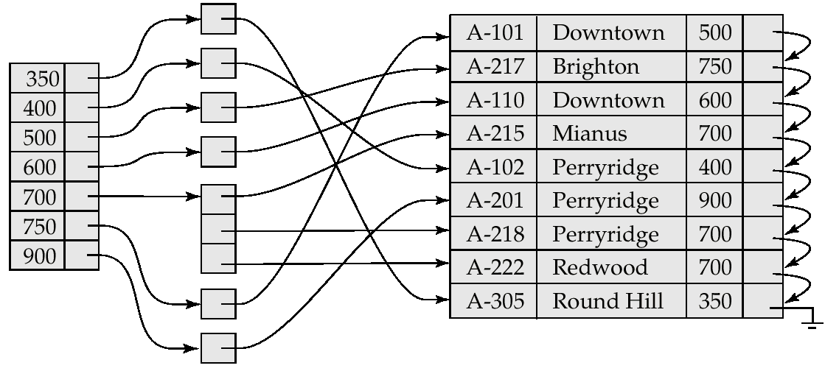
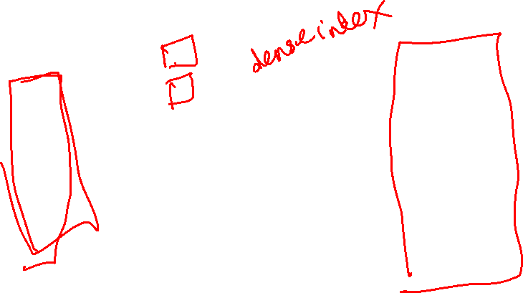
Secondary Index on balance field of account

Slide 14
Primary and Secondary Indices
Secondary indices have to be dense.
Indices offer substantial benefits when searching for records.
When a file is modified, every index on the file must be updated, Updating indices imposes overhead on database modification.
Sequential scan using primary index is efficient, but a sequential scan using a secondary index is expensive
each record access may fetch a new block from disk

Slide 15
B⁺-Tree Index Files
B⁺-tree indices are an alternative to indexed-sequential files.
Disadvantage of indexed-sequential files: performance degrades as file grows, since many overflow blocks get created. Periodic reorganization of entire file is required.
Advantage of B⁺-tree index files: automatically reorganizes itself with small, local, changes, in the face of insertions and deletions. Reorganization of entire file is not required to maintain performance.
Disadvantage of B⁺-trees: extra insertion and deletion overhead, space overhead.
Advantages of B⁺-trees outweigh disadvantages, and they are used extensively.

Slide 16
B⁺-Tree Index Files (Cont.)
A B⁺-tree is a rooted tree satisfying the following properties:
All paths from root to leaf are of the same length
Each node that is not a root or a leaf has between [n/2] and n children.
A leaf node has between [(n–1)/2] and n–1 values
Special cases:
If the root is not a leaf, it has at least 2 children.
If the root is a leaf (that is, there are no other nodes in the tree), it can have between 0 and (n–1) values.

Slide 17
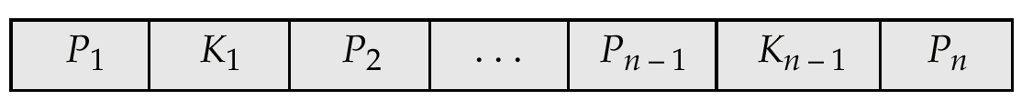
B⁺-Tree Node Structure
Typical node
K_{i} are the search-key values
P_{i} are pointers to children (for non-leaf nodes) or pointers to records or buckets of records (for leaf nodes).
The search-keys in a node are ordered
K₁ < K₂ < K₃ < . . . < K_{n–1}

Slide 18
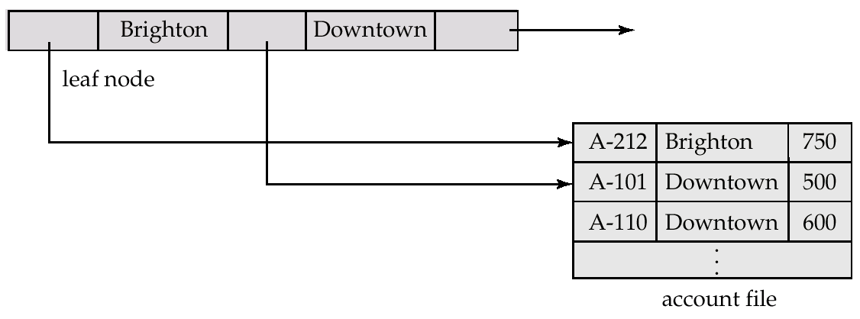
Leaf Nodes in B⁺-Trees
Properties of a leaf node:
For i = 1, 2, . . ., n–1, pointer P_{i} either points to a file record with search-key value K_{i}, or to a bucket of pointers to file records, each record having search-key value K_{i}. Only need bucket structure if search-key does not form a primary key.
If L_{i}, L_{j} are leaf nodes and i < j, L_{i}’s search-key values are less than L_{j}’s search-key values
P_{n} points to next leaf node in search-key order

Slide 19
Non-Leaf Nodes in B⁺-Trees
Non leaf nodes form a multi-level sparse index on the leaf nodes. For a non-leaf node with m pointers:
All the search-keys in the subtree to which P₁ points are less than K₁
For 2 ≤ i ≤ n – 1, all the search-keys in the subtree to which P_{i} points have values greater than or equal to K_{i–1} and less than K_{m–1}

Slide 20
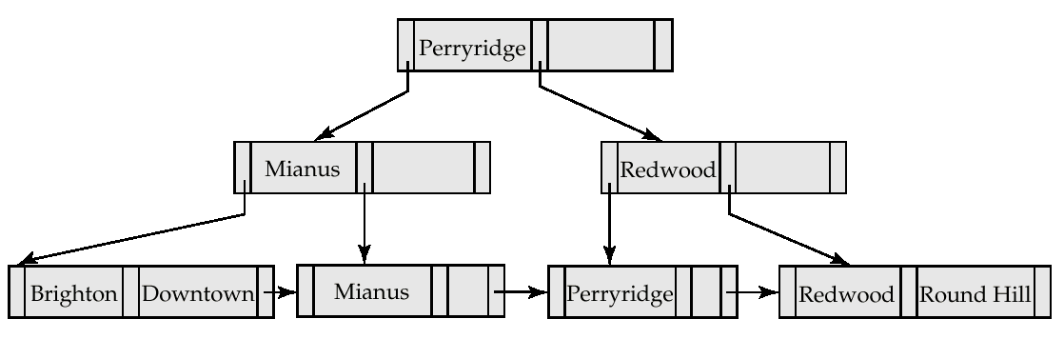
Example of a B⁺-tree
B⁺-tree for account file (n = 3)

Slide 21
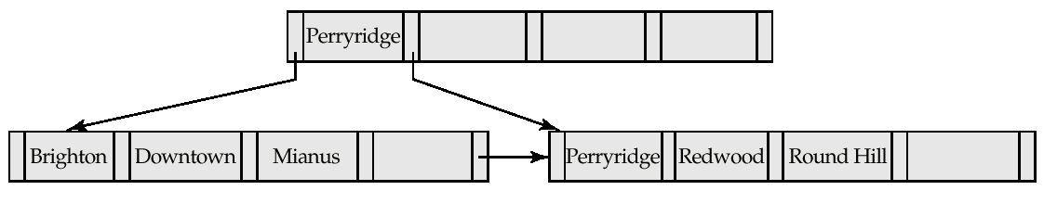
Example of B⁺-tree
B⁺-tree for account file (n = 5)
Leaf nodes must have between 2 and 4 values (⎡(n–1)/2⎤ and n –1, with n = 5).
Non-leaf nodes other than root must have between 3 and 5 children (⎡(n/2⎤ and n with n =5).
Root must have at least 2 children.

Slide 22
Observations about B⁺-trees
Since the inter-node connections are done by pointers, “logically” close blocks need not be “physically” close.
The non-leaf levels of the B⁺-tree form a hierarchy of sparse indices.
The B⁺-tree contains a relatively small number of levels (logarithmic in the size of the main file), thus searches can be conducted efficiently.
Insertions and deletions to the main file can be handled efficiently, as the index can be restructured in logarithmic time (as we shall see).

Slide 23
Queries on B⁺-Trees
Find all records with a search-key value of k.
Start with the root node
Examine the node for the smallest search-key value > k.
If such a value exists, assume it is K_{j}. Then follow P_{i} to the child node
Otherwise k ≥ K_{m–1}, where there are m pointers in the node. Then follow P_{m} to the child node.
If the node reached by following the pointer above is not a leaf node, repeat the above procedure on the node, and follow the corresponding pointer.
Eventually reach a leaf node. If for some i, key K_{i} = k follow pointer P_{i} to the desired record or bucket. Else no record with search-key value k exists.

Slide 24
Queries on B⁺⁻Trees (Cont.)
In processing a query, a path is traversed in the tree from the root to some leaf node.
If there are K search-key values in the file, the path is no longer than ⎡ log_{⎡n/2⎤}(K)⎤.
A node is generally the same size as a disk block, typically 4 kilobytes, and n is typically around 100 (40 bytes per index entry).
With 1 million search key values and n = 100, at most log₅₀(1,000,000) = 4 nodes are accessed in a lookup.
Contrast this with a balanced binary tree with 1 million search key values — around 20 nodes are accessed in a lookup
above difference is significant since every node access may need a disk I/O, costing around 20 milliseconds!

Slide 25
Updates on B⁺-Trees: Insertion
Find the leaf node in which the search-key value would appear
If the search-key value is already there in the leaf node, record is added to file and if necessary a pointer is inserted into the bucket.
If the search-key value is not there, then add the record to the main file and create a bucket if necessary. Then:
If there is room in the leaf node, insert (key-value, pointer) pair in the leaf node
Otherwise, split the node (along with the new (key-value, pointer) entry) as discussed in the next slide.

Slide 26
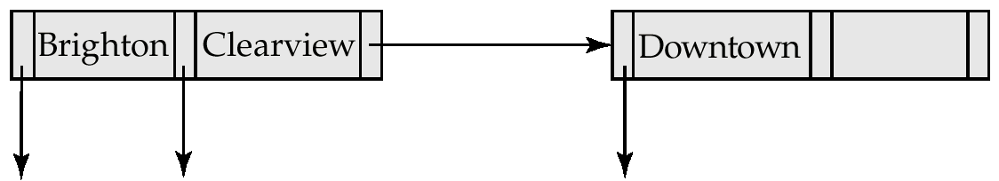
Updates on B⁺-Trees: Insertion (Cont.)
Splitting a node:
take the n(search-key value, pointer) pairs (including the one being inserted) in sorted order. Place the first ⎡ n/2 ⎤ in the original node, and the rest in a new node.
let the new node be p, and let k be the least key value in p. Insert (k,p) in the parent of the node being split. If the parent is full, split it and propagate the split further up.
The splitting of nodes proceeds upwards till a node that is not full is found. In the worst case the root node may be split increasing the height of the tree by 1.
Result of splitting node containing Brighton and Downtown on inserting Clearview

Slide 27
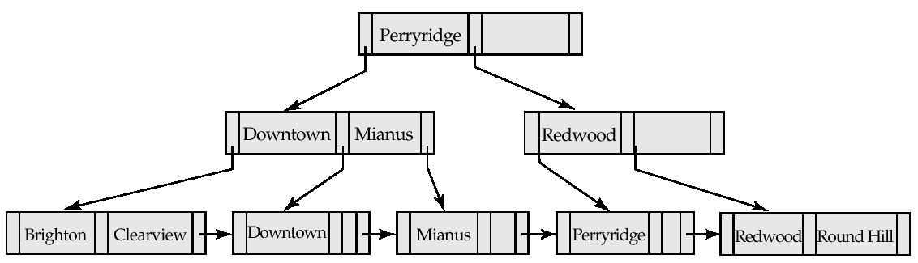

Updates on B⁺-Trees: Insertion (Cont.)
B⁺-Tree before and after insertion of “Clearview”

Slide 28
Updates on B⁺-Trees: Deletion
Find the record to be deleted, and remove it from the main file and from the bucket (if present)
Remove (search-key value, pointer) from the leaf node if there is no bucket or if the bucket has become empty
If the node has too few entries due to the removal, and the entries in the node and a sibling fit into a single node, then
Insert all the search-key values in the two nodes into a single node (the one on the left), and delete the other node.
Delete the pair (K_{i–1}, P_{i}), where P_{i} is the pointer to the deleted node, from its parent, recursively using the above procedure.

Slide 29
Updates on B⁺-Trees: Deletion
Otherwise, if the node has too few entries due to the removal, and the entries in the node and a sibling fit into a single node, then
Redistribute the pointers between the node and a sibling such that both have more than the minimum number of entries.
Update the corresponding search-key value in the parent of the node.
The node deletions may cascade upwards till a node which has ⎡n/2 ⎤ or more pointers is found. If the root node has only one pointer after deletion, it is deleted and the sole child becomes the root.

Slide 30
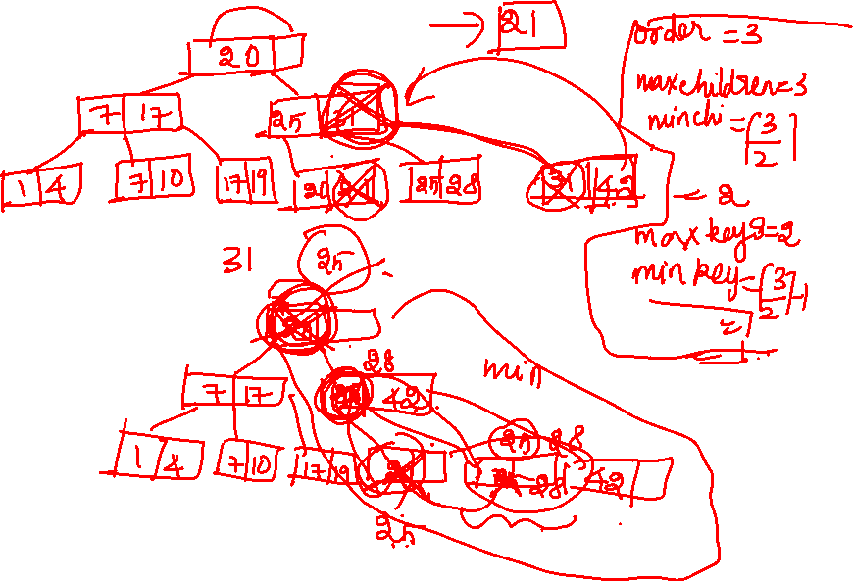

Slide 31
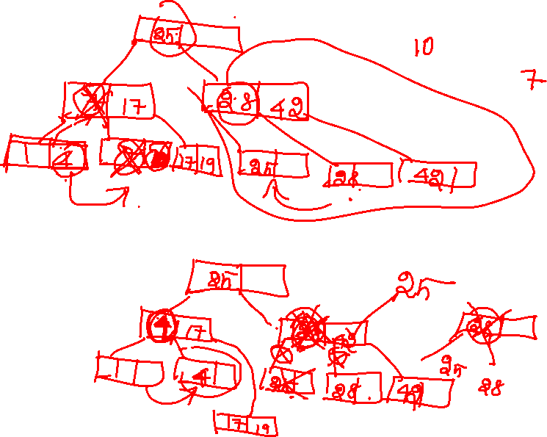

Slide 32
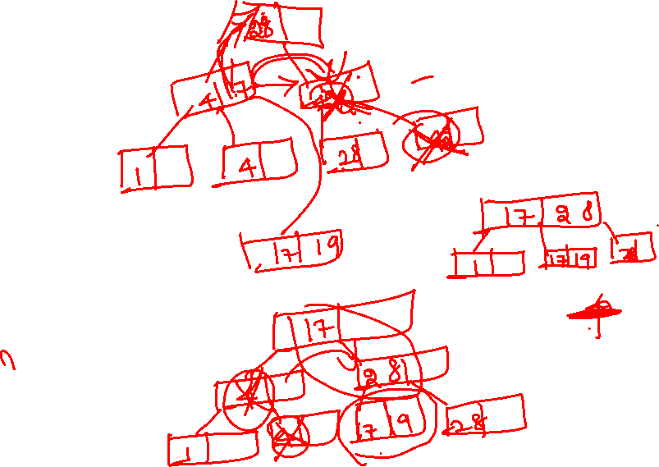

Slide 33
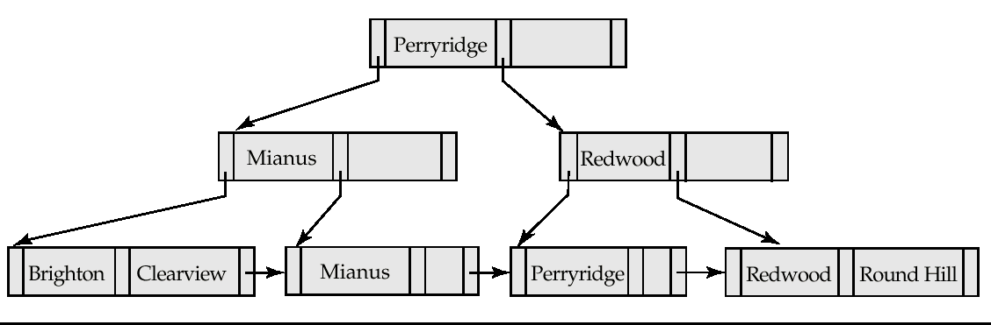
Examples of B⁺-Tree Deletion
Before and after deleting “Downtown”
The removal of the leaf node containing “Downtown” did not result in its parent having too little pointers. So the cascaded deletions stopped with the deleted leaf node’s parent.

Slide 34
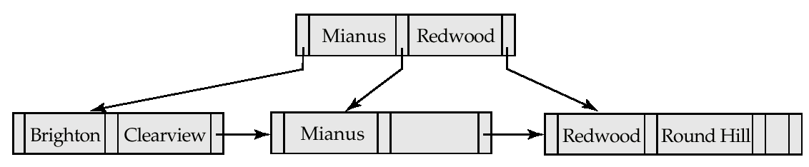
Examples of B⁺-Tree Deletion (Cont.)
Deletion of “Perryridge” from result of previous example
Node with “Perryridge” becomes underfull (actually empty, in this special case) and merged with its sibling.
As a result “Perryridge” node’s parent became underfull, and was merged with its sibling (and an entry was deleted from their parent)
Root node then had only one child, and was deleted and its child became the new root node

Slide 35
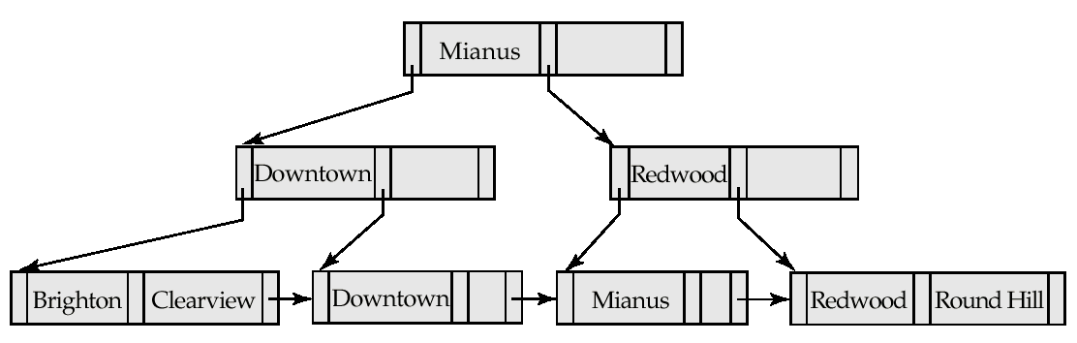
Example of B⁺-tree Deletion (Cont.)
Before and after deletion of “Perryridge” from earlier example
Parent of leaf containing Perryridge became underfull, and borrowed a pointer from its left sibling
Search-key value in the parent’s parent changes as a result

Slide 36
B⁺-Tree File Organization
Index file degradation problem is solved by using B⁺-Tree indices. Data file degradation problem is solved by using B⁺-Tree File Organization.
The leaf nodes in a B⁺-tree file organization store records, instead of pointers.
Since records are larger than pointers, the maximum number of records that can be stored in a leaf node is less than the number of pointers in a nonleaf node.
Leaf nodes are still required to be half full.
Insertion and deletion are handled in the same way as insertion and deletion of entries in a B⁺-tree index.

Slide 37
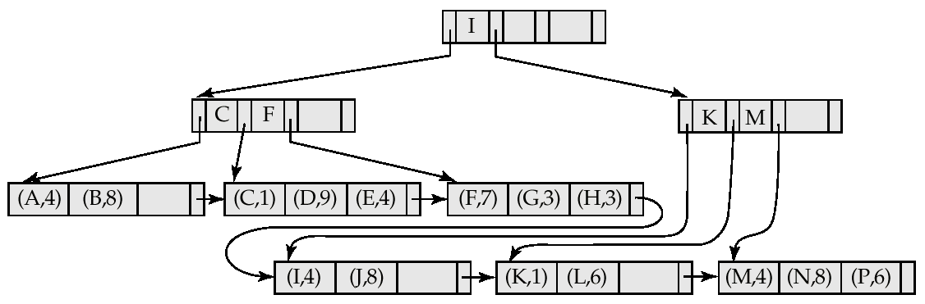

B⁺-Tree File Organization (Cont.)
Example of B⁺-tree File Organization
Good space utilization important since records use more space than pointers.
To improve space utilization, involve more sibling nodes in redistribution during splits and merges
Involving 2 siblings in redistribution (to avoid split / merge where possible) results in each node having at least entries

Slide 38
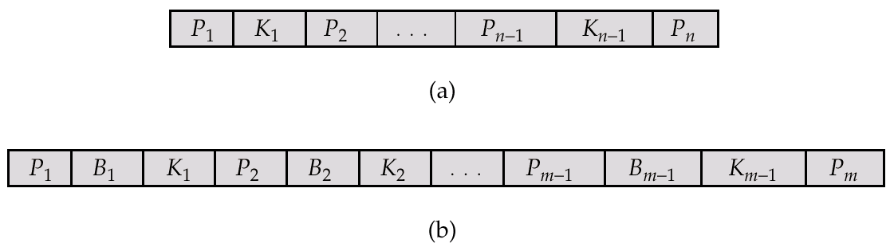
B-Tree Index Files
Similar to B+-tree, but B-tree allows search-key values to appear only once; eliminates redundant storage of search keys.
Search keys in nonleaf nodes appear nowhere else in the B-tree; an additional pointer field for each search key in a nonleaf node must be included.
Generalized B-tree leaf node
Nonleaf node – pointers B_{i} are the bucket or file record pointers.

Slide 39
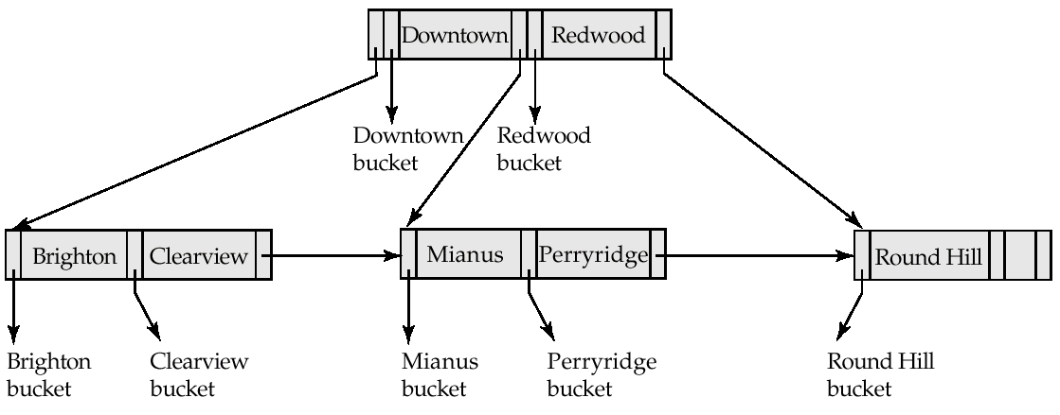
B-Tree Index File Example
B-tree (above) and B+-tree (below) on same data

Slide 40
B-Tree Index Files (Cont.)
Advantages of B-Tree indices:
May use less tree nodes than a corresponding B⁺-Tree.
Sometimes possible to find search-key value before reaching leaf node.
Disadvantages of B-Tree indices:
Only small fraction of all search-key values are found early
Non-leaf nodes are larger, so fan-out is reduced. Thus, B-Trees typically have greater depth than corresponding B⁺-Tree
Insertion and deletion more complicated than in B⁺-Trees
Implementation is harder than B⁺-Trees.
Typically, advantages of B-Trees do not out weigh disadvantages.

Slide 41
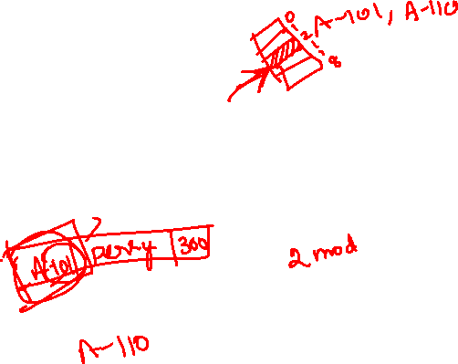
Static Hashing
A bucket is a unit of storage containing one or more records (a bucket is typically a disk block).
In a hash file organization we obtain the bucket of a record directly from its search-key value using a hash function.
Hash function h is a function from the set of all search-key values K to the set of all bucket addresses B.
Hash function is used to locate records for access, insertion as well as deletion.
Records with different search-key values may be mapped to the same bucket; thus entire bucket has to be searched sequentially to locate a record.

Slide 42

Example of Hash File Organization (Cont.)
Hash file organization of account file, using branch-name as key (See figure in next slide.)
There are 10 buckets,
The binary representation of the ith character is assumed to be the integer i.
The hash function returns the sum of the binary representations of the characters modulo 10
E.g. h(Perryridge) = 5 h(Round Hill) = 3 h(Brighton) = 3

Slide 43
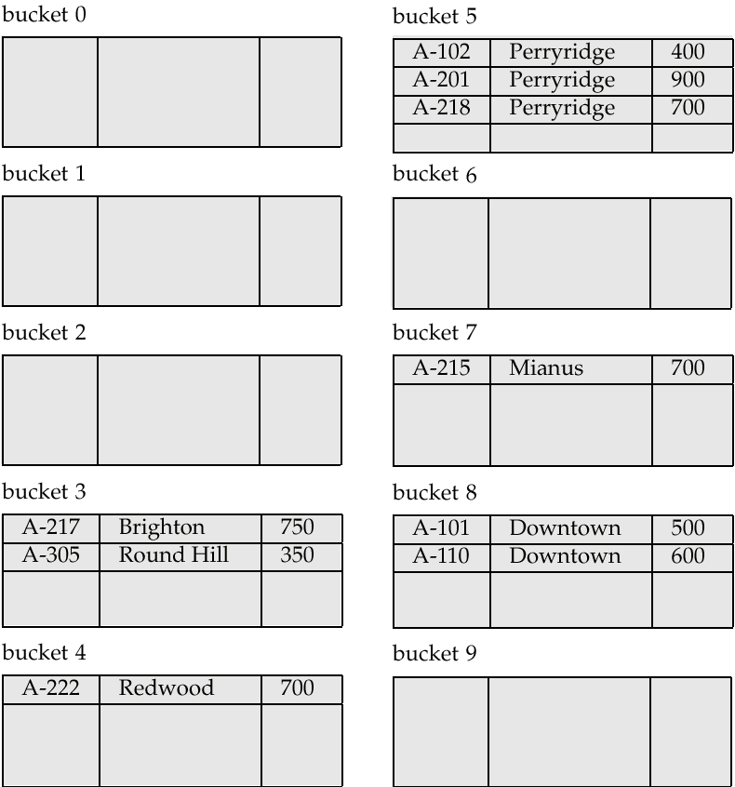

Hash file organization of account file, using branch-name as key (see previous slide for details).

Slide 44
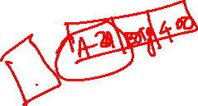
Hash Functions
Worst has function maps all search-key values to the same bucket; this makes access time proportional to the number of search-key values in the file.
An ideal hash function is uniform, i.e., each bucket is assigned the same number of search-key values from the set of all possible values.
Ideal hash function is random, so each bucket will have the same number of records assigned to it irrespective of the actual distribution of search-key values in the file.
Typical hash functions perform computation on the internal binary representation of the search-key.
For example, for a string search-key, the binary representations of all the characters in the string could be added and the sum modulo the number of buckets could be returned. .

Slide 45
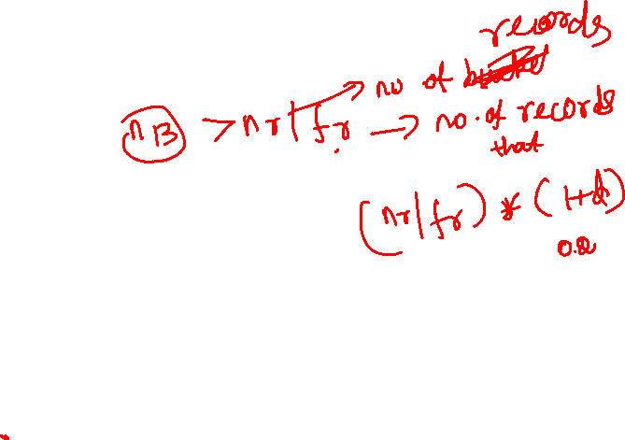
Handling of Bucket Overflows
Bucket overflow can occur because of
Insufficient buckets
Skew in distribution of records. This can occur due to two reasons:
multiple records have same search-key value
chosen hash function produces non-uniform distribution of key values
Although the probability of bucket overflow can be reduced, it cannot be eliminated; it is handled by using overflow buckets.

Slide 46
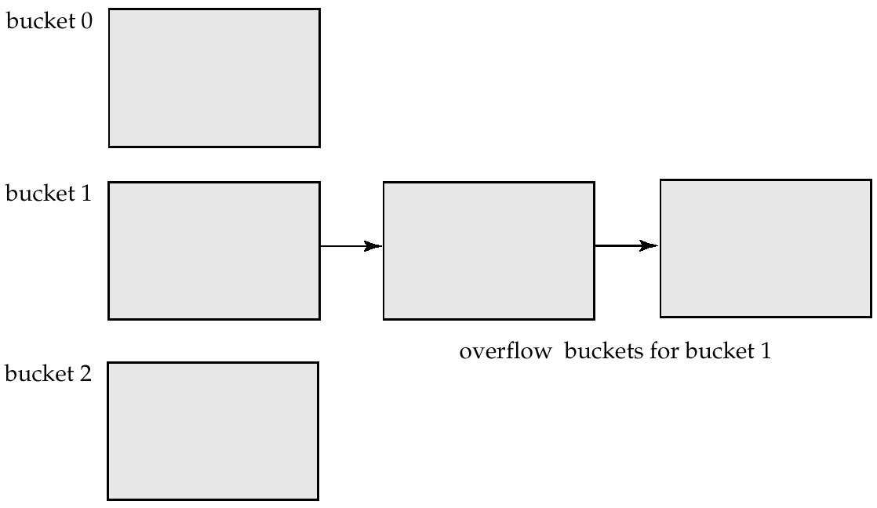

Handling of Bucket Overflows (Cont.)
Overflow chaining – the overflow buckets of a given bucket are chained together in a linked list.
Above scheme is called closed hashing.
An alternative, called open hashing, which does not use overflow buckets, is not suitable for database applications.

Slide 47
Hash Indices
Hashing can be used not only for file organization, but also for index-structure creation.
A hash index organizes the search keys, with their associated record pointers, into a hash file structure.
Strictly speaking, hash indices are always secondary indices
if the file itself is organized using hashing, a separate primary hash index on it using the same search-key is unnecessary.
However, we use the term hash index to refer to both secondary index structures and hash organized files.

Slide 48
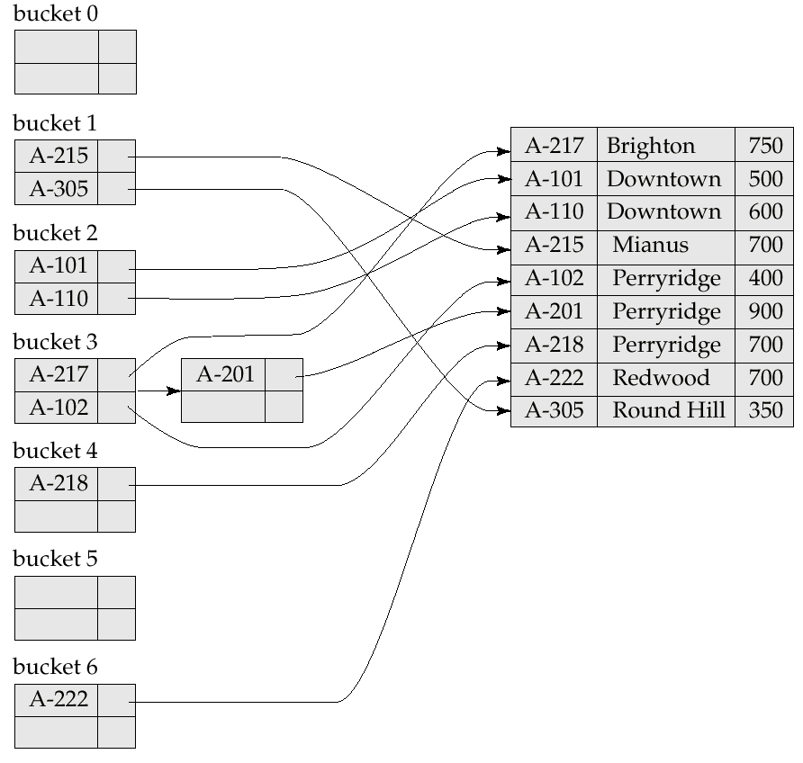
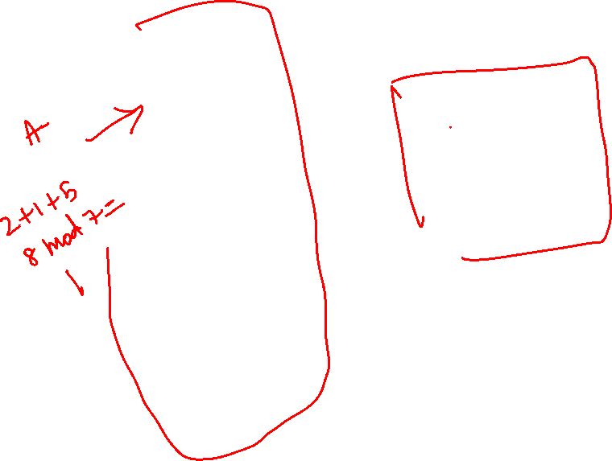
Example of Hash Index

Slide 49
Deficiencies of Static Hashing
In static hashing, function h maps search-key values to a fixed set of B of bucket addresses.
Databases grow with time. If initial number of buckets is too small, performance will degrade due to too much overflows.
If file size at some point in the future is anticipated and number of buckets allocated accordingly, significant amount of space will be wasted initially.
If database shrinks, again space will be wasted.
One option is periodic re-organization of the file with a new hash function, but it is very expensive.
These problems can be avoided by using techniques that allow the number of buckets to be modified dynamically.

Slide 50
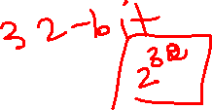

Dynamic Hashing
Good for database that grows and shrinks in size
Allows the hash function to be modified dynamically
Extendable hashing – one form of dynamic hashing
Hash function generates values over a large range — typically b-bit integers, with b = 32.
At any time use only a prefix of the hash function to index into a table of bucket addresses.
Let the length of the prefix be i bits, 0 ≤ i ≤ 32.
Bucket address table size = 2^{i.} Initially i = 0
Value of i grows and shrinks as the size of the database grows and shrinks.
Multiple entries in the bucket address table may point to a bucket.
Thus, actual number of buckets is < 2^{i}
The number of buckets also changes dynamically due to coalescing and splitting of buckets.

Slide 51
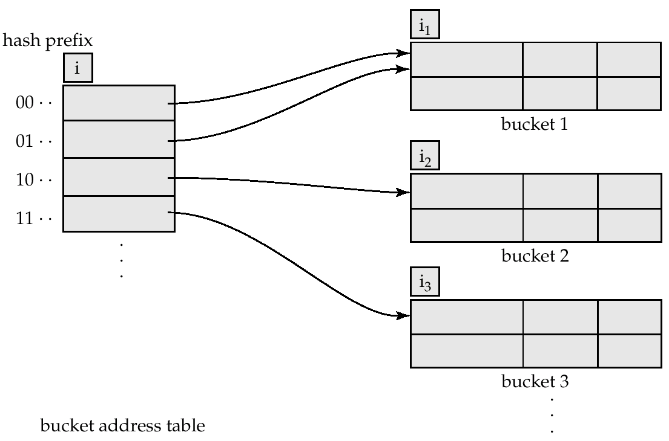

General Extendable Hash Structure
In this structure, i₂ = i₃ = i, whereas i₁ = i – 1 (see next slide for details)

Slide 52
Use of Extendable Hash Structure
Each bucket j stores a value i_{j}; all the entries that point to the same bucket have the same values on the first i_{j} bits.
To locate the bucket containing search-key K_{j}:
1. Compute h(K_{j}) = X
2. Use the first i high order bits of X as a displacement into bucket address table, and follow the pointer to appropriate bucket
To insert a record with search-key value K_{j}
follow same procedure as look-up and locate the bucket, say j.
If there is room in the bucket j insert record in the bucket.
Else the bucket must be split and insertion re-attempted (next slide.)
Overflow buckets used instead in some cases (will see shortly)

Slide 53
Updates in Extendable Hash Structure
To split a bucket j when inserting record with search-key value K_{j}:
If i > i_{j} (more than one pointer to bucket j)
allocate a new bucket z, and set i_{j} and i_{z} to the old i_{j} -+ 1.
make the second half of the bucket address table entries pointing to j to point to z
remove and reinsert each record in bucket j.
recompute new bucket for K_{j} and insert record in the bucket (further splitting is required if the bucket is still full)
If i = i_{j} (only one pointer to bucket j)
increment i and double the size of the bucket address table.
replace each entry in the table by two entries that point to the same bucket.
recompute new bucket address table entry for K_{j} Now i > i_{j} so use the first case above.

Slide 54
Updates in Extendable Hash Structure (Cont.)
When inserting a value, if the bucket is full after several splits (that is, i reaches some limit b) create an overflow bucket instead of splitting bucket entry table further.
To delete a key value,
locate it in its bucket and remove it.
The bucket itself can be removed if it becomes empty (with appropriate updates to the bucket address table).
Coalescing of buckets can be done (can coalesce only with a “buddy” bucket having same value of i_{j} and same i_{j} –1 prefix, if it is present)
Decreasing bucket address table size is also possible
Note: decreasing bucket address table size is an expensive operation and should be done only if number of buckets becomes much smaller than the size of the table

Slide 55
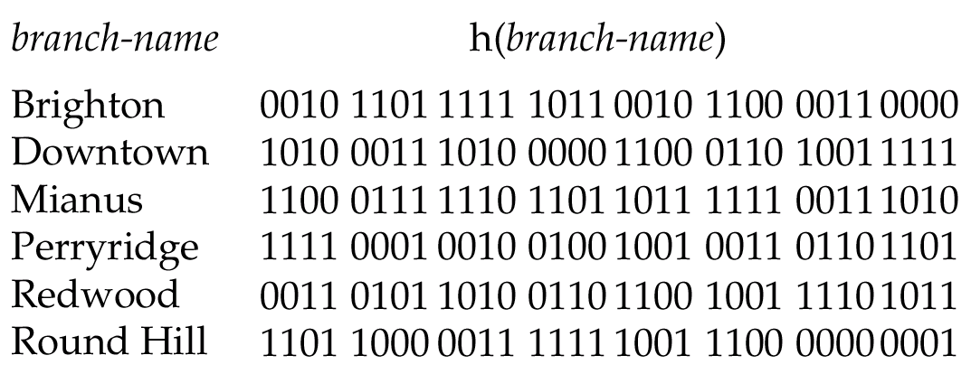
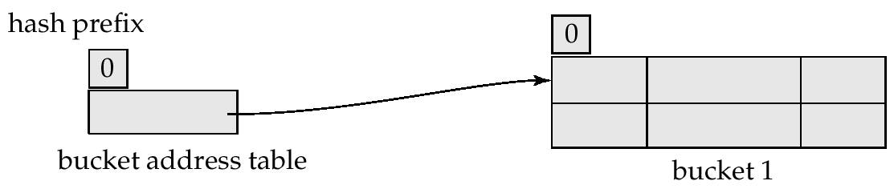
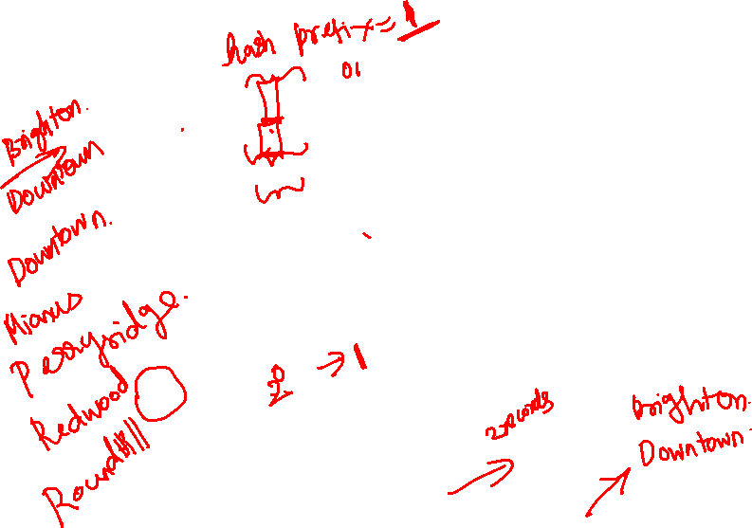
Use of Extendable Hash Structure: Example
Initial Hash structure, bucket size = 2

Slide 56
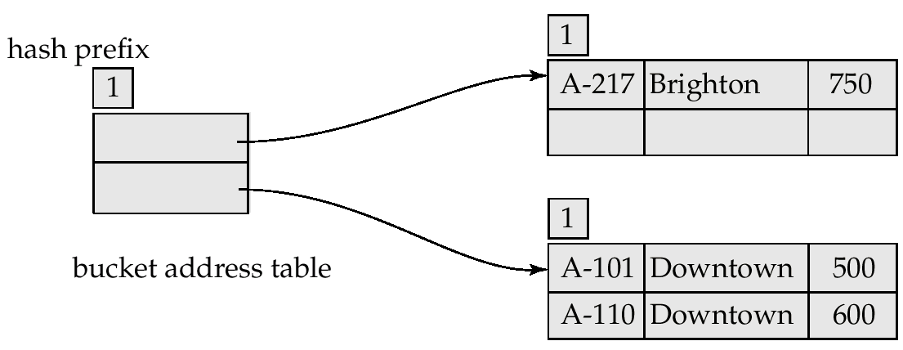
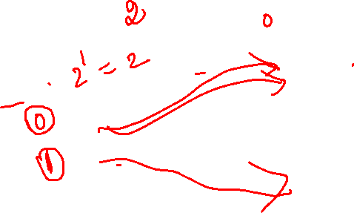
Example (Cont.)
Hash structure after insertion of one Brighton and two Downtown records

Slide 57
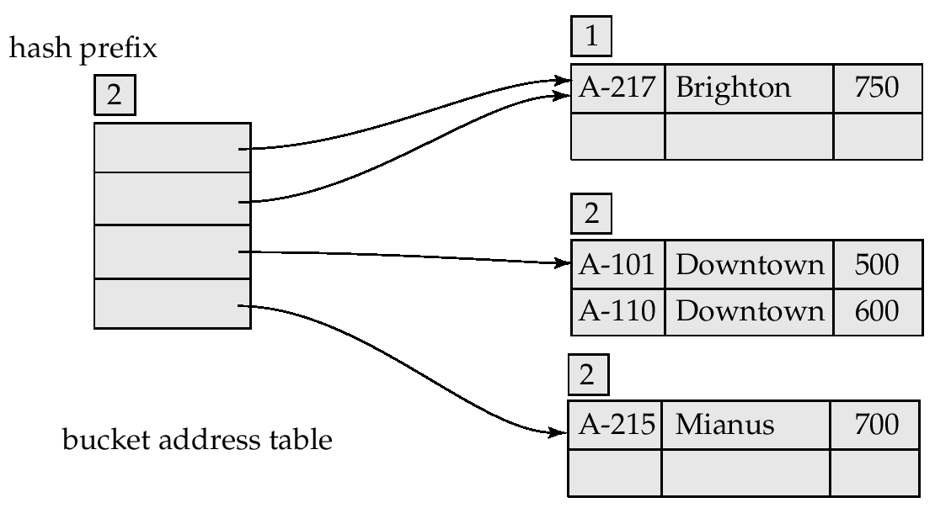
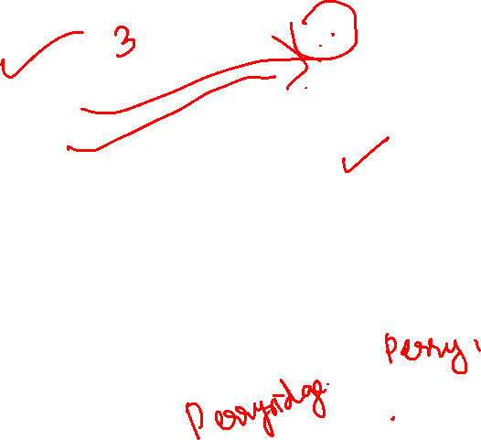
Example (Cont.)
Hash structure after insertion of Mianus record

Slide 58
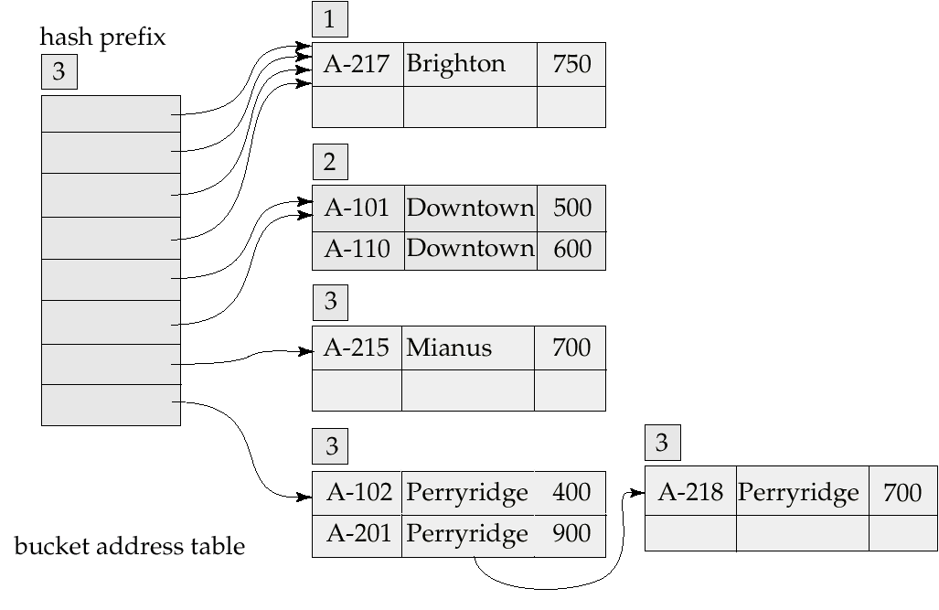
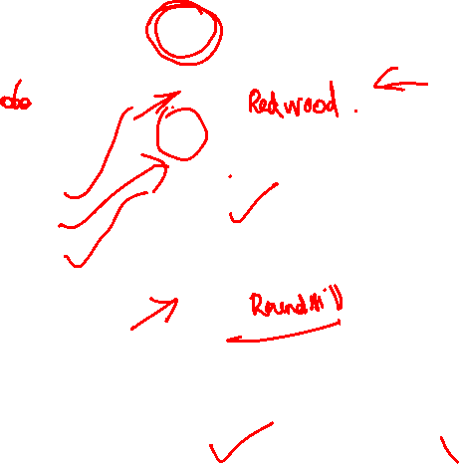
Example (Cont.)
Hash structure after insertion of three Perryridge records

Slide 59
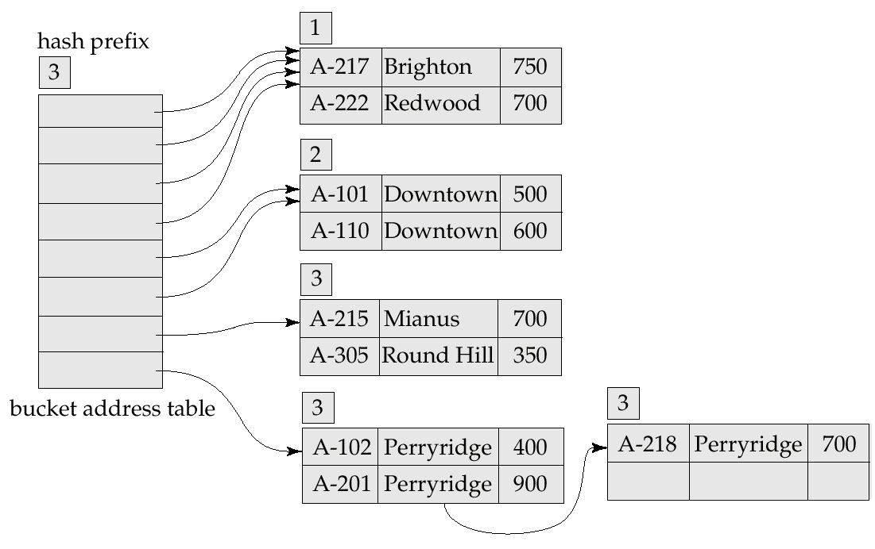
Example (Cont.)
Hash structure after insertion of Redwood and Round Hill records

Slide 60
Extendable Hashing vs. Other Schemes
Benefits of extendable hashing:
Hash performance does not degrade with growth of file
Minimal space overhead
Disadvantages of extendable hashing
Extra level of indirection to find desired record
Bucket address table may itself become very big (larger than memory)
Need a tree structure to locate desired record in the structure!
Changing size of bucket address table is an expensive operation
Linear hashing is an alternative mechanism which avoids these disadvantages at the possible cost of more bucket overflows

Slide 61
Comparison of Ordered Indexing and Hashing
Cost of periodic re-organization
Relative frequency of insertions and deletions
Is it desirable to optimize average access time at the expense of worst-case access time?
Expected type of queries:
Hashing is generally better at retrieving records having a specified value of the key.
If range queries are common, ordered indices are to be preferred

Slide 62
Index Definition in SQL
Create an index
create index <index-name> on <relation-name> (<attribute-list>)
E.g.: create index b-index on branch(branch-name)
Use create unique index to indirectly specify and enforce the condition that the search key is a candidate key is a candidate key.
Not really required if SQL unique integrity constraint is supported
To drop an index
drop index <index-name>

Slide 63

Thank You!!!

